Slide 1
Convergence, local minima, global minima

Slide 2
The point at which a function takes the minimum value is called as global minima. However, when the goal is to minimize the function and solved using optimization algorithms such as gradient descent, it may so happen that function may appear to have minimum value at different points. Those several points which appear to be minima but is not the point where the function actually takes the minimum value is called as local minima. Take a look at the following picture to understand the concept of local minima and global minima.

Slide 3
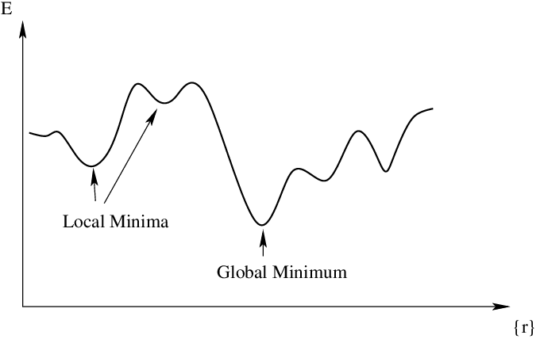
Global and local minima
loss
weights

Slide 4
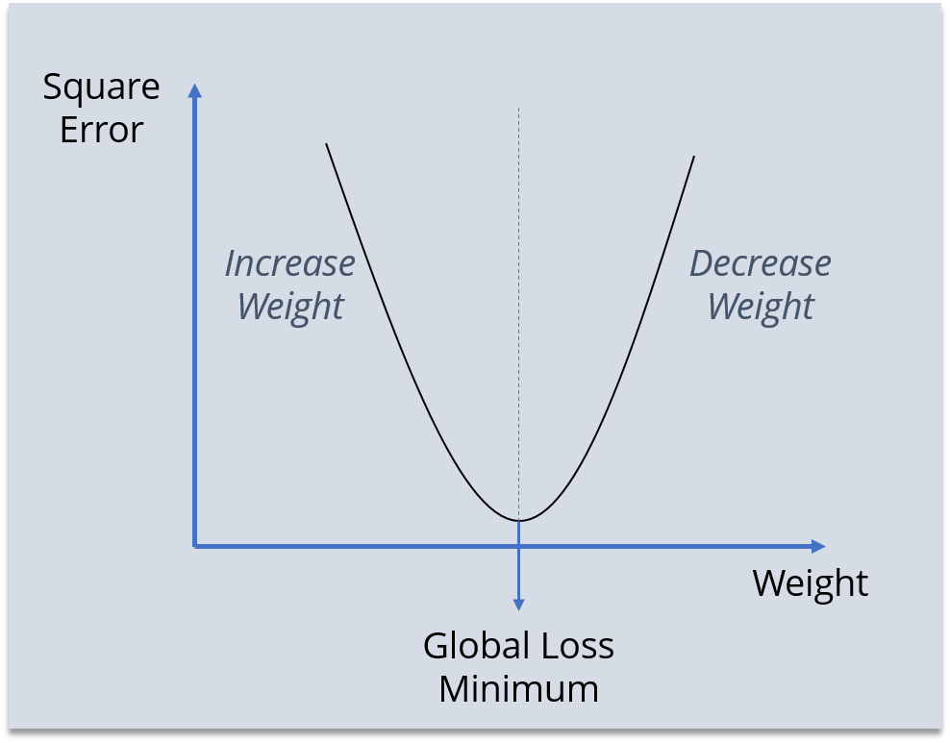
This is global minima

Slide 5
The gradient at different points is found out.
If the gradient value is positive at a point, it will be required to move to left or reduce the weight.
If the gradient value is negative at a point, it will be required to increment the value of weight.
The above two steps are done until the minima is reached.
The minima could either be local minima or the global minima. There are different techniques which can be used to find local vs global minima.

Slide 6
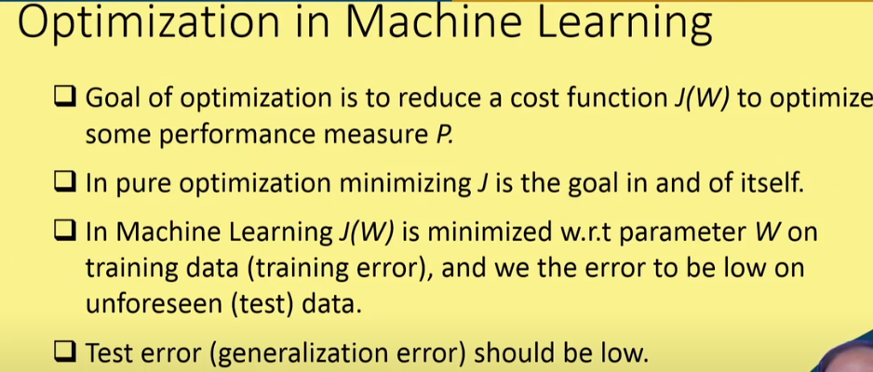

Slide 7
Convergence and Local Minima
Backpropagation is only guaranteed to converge to a local, and not a global, minima. However, since each weight in a network essentially corresponds to a different dimension in the error space, a local minimum with respect to one weight may not be a local minimum with respect to other weights. This can provide an “escape route” from becoming trapped in local minima. If the weights are initialized to values close to zero, the sigmoid threshold function is approximately linear and so they produce linear outputs. As the weights grow, though, the network is able to represent more complex functions that are not linear in nature. It is the hope that by the time the weights are able to approximate the desired function that they will be close enough to the global minimum that even becoming stuck in a local minima will be acceptable.

Slide 8
Common heuristic methods to reduce the problem of local minima are:
Add a momentum term to the weight-update rule
Use stochastic gradient descent rather than true gradient descent
Train multiple networks using the same training data but initialize the networks with different random weights.
If the different networks lead to different local minima, choose the network that performs best on a validation set of data or all networks can be kept and treated as a committee whose output is the (possibly weighted) average of individual network outputs.

Slide 9
Variants of gradient decent or optimization techniques
Batch gradient descent- normal gradient descent
Stochastic gradient descent
Mini batch gradient decent
Momentum based gradient descent

Slide 10
Batch Gradient Descent
Let’s say there are a total of ‘m’ observations in a data set and we use all these observations to calculate the cost function J or loss, then this is known as Batch Gradient Descent.
So we take the entire training set, perform forward propagation and calculate the cost function. And then we update the parameters using the rate of change of this cost function with respect to the parameters. An epoch is when the entire training set is passed through the model, forward propagation and backward propagation are performed and the parameters are updated. In batch Gradient Descent since we are using the entire training set, the parameters will be updated only once per epoch.

Slide 11
Disadvantages of Batch Gradient Descent
Perform redundant computation for the same training example for large datasets.
Can be very slow and intractable as large datasets may not fit in the memory.
As we take the entire dataset for computation we can update the weights of the model for the new data.

Slide 12
Stochastic Gradient Descent(SGD)
If you use a single observation to calculate the cost function it is known as Stochastic Gradient Descent, commonly abbreviated as SGD. We pass a single observation at a time, calculate the cost and update the parameter
Let’s say we have 5 observations and each observation has three features and the values that I’ve taken are completely random. See in next slide

Slide 13
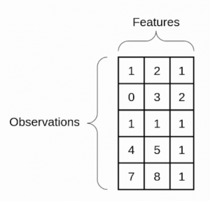
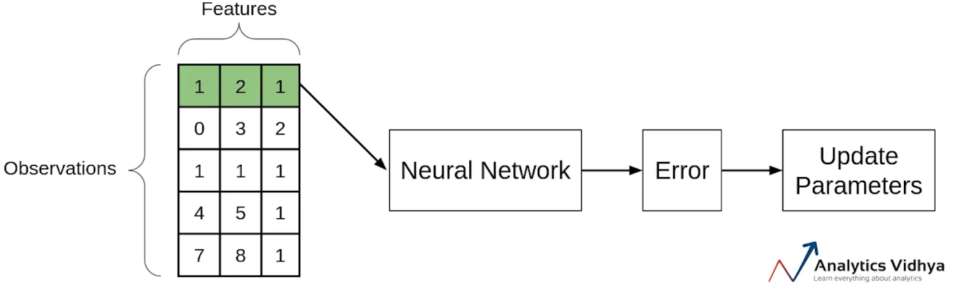
Now if we use the SGD, will take the first observation, then pass it through the neural network, calculate the error and then update the parameters.
Then will take the second observation and perform similar steps with it. This step will be repeated until all observations have been passed through the network and the parameters have been updated.

Slide 14
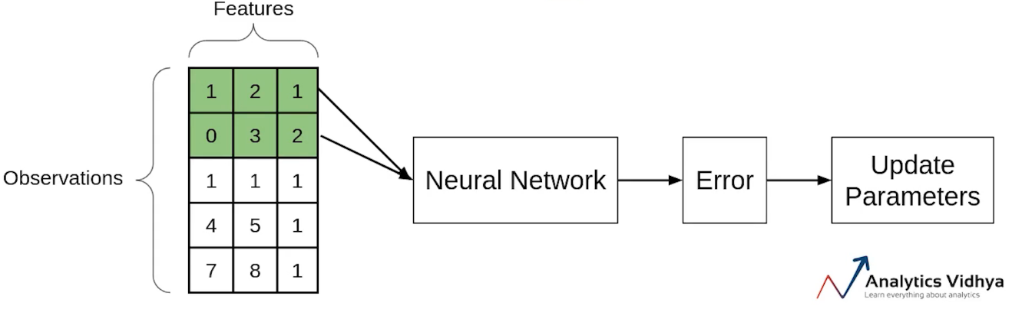
Mini-batch Gradient Descent
Another type of Gradient Descent is the Mini-batch Gradient Descent. It takes a subset of the entire dataset to calculate the cost function. So if there are ‘m’ observations then the number of observations in each subset or mini-batches will be more than 1 and less than ‘m’.
Again let’s take the same example. Assume that the batch size is 2. So we’ll take the first two observations, pass them through the neural network, calculate the error and then update the parameters.
Then we will take the next two observations and perform similar steps i.e will pass through the network, calculate the error and update the parameters.

Slide 15
Momentum based gradient descent
What is the problem with all the variant of gradient descent is that it takes lot of time to pass through the gentle slope.This is because at gentle slope gradient is very small so update becomes slow.
To solve this problem we will use the idea of momentum incorporated to gradient descent.
What is momentum?
Momentum is like a ball rolling downhill. The ball will gain momentum as it rolls down the hill.
In simple term,you want to reach to the destination which entirely new for you.what will you do. You will ask direction from the person nearby. That person will direct you in some direction so you move in that direction slowly. After reaching certain distance , again you ask the another person for the direction and that person also point you in the same direction, then you will move in that direction with bit more acceleration. So your acceleration will definitely increase as you gain information for the later person and earlier person are same. This phenomena is called momentum.

Slide 16
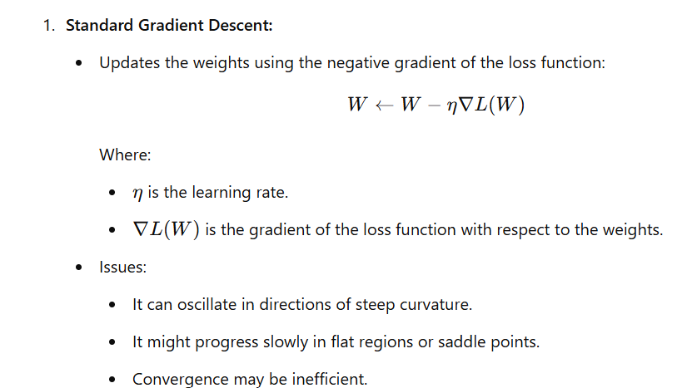

Slide 17
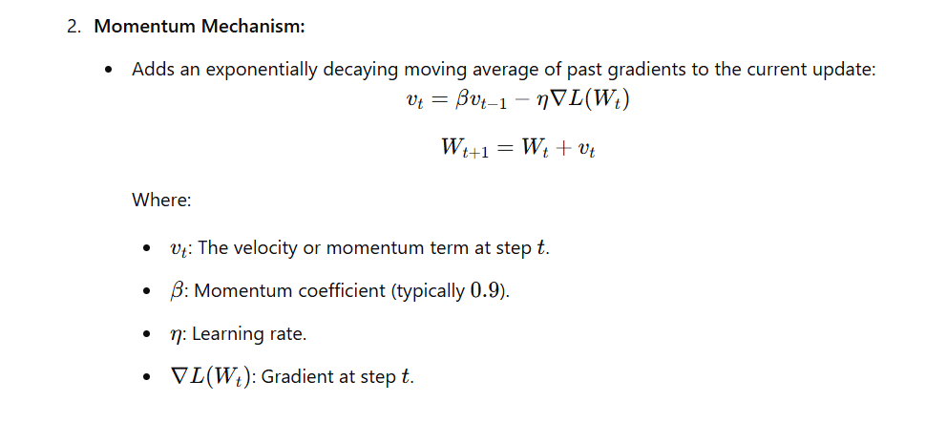

Slide 18
Significance of Gradient Descent with Momentum:
Accelerates Convergence
Reduces Oscillations
Escapes Saddle Points
Improved Stability:

Slide 19
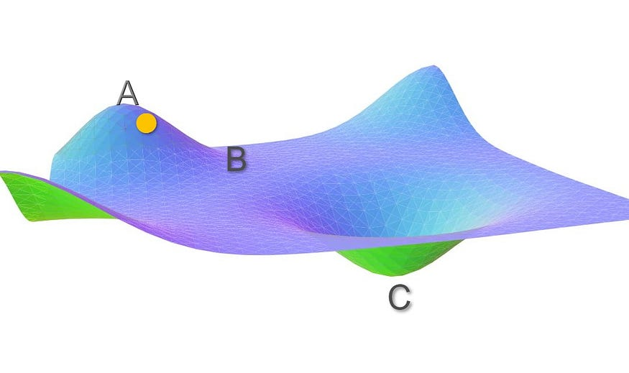

Slide 20
To account for the momentum, we can use a moving average over the past gradients. In regions where the gradient is high like AB, weight updates will be large. Thus, in a way we are gathering momentum by taking a moving average over these gradients. But there is a problem with this method, it considers all the gradients over iterations with equal weightage. The gradient at t=0 has equal weightage as that of the gradient at current iteration t. We need to use some sort of weighted average of the past gradients such that the recent gradients are given more weightage.

Slide 21
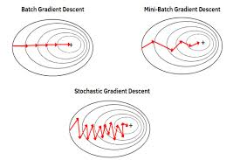

Slide 22
